Slide 1
See Through
A Project For those concerned with Aesthetic Authenticity
By: The Elon Musketeers
(Angelo Mandato and Ese Osaghae)

Slide 2
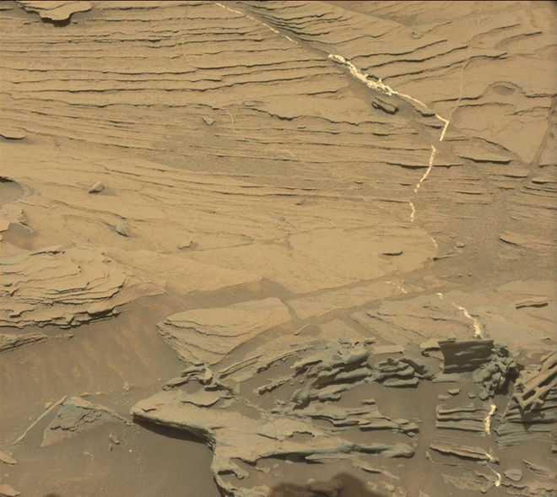

Slide 3
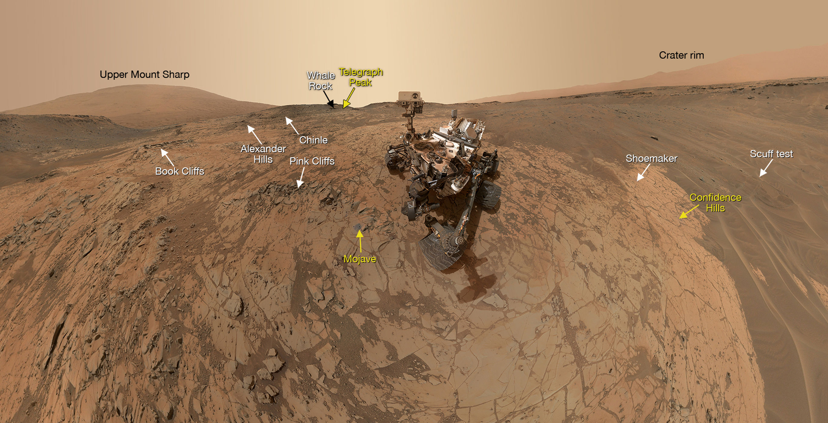

Slide 4
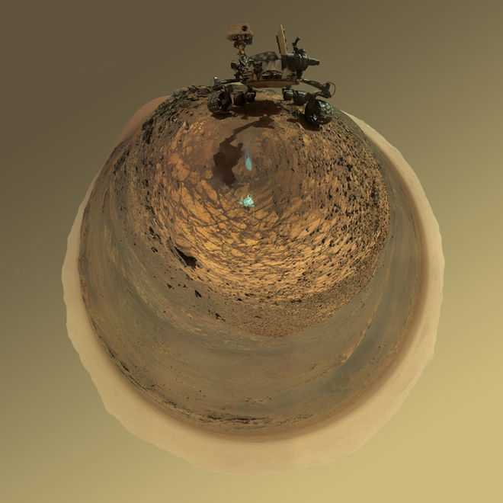

Slide 5
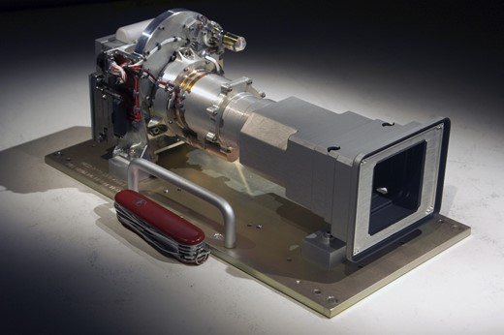
Current Format of Camera
A high tech 2 MP camera is currently used for the Mars Curiosity Rover

Slide 6
Problem
Being able to focus a camera without extensive control after multiple shots
In order to get a 3D landscape picture physics and camera angle geometry are problematic
The pictures taken by this camera are of high quality, but there is a vast of data taken.
A lot of snapshots to ensure good pictures

Slide 7
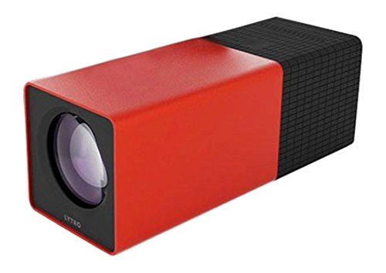
Lytro
Light-field Photography

Slide 8
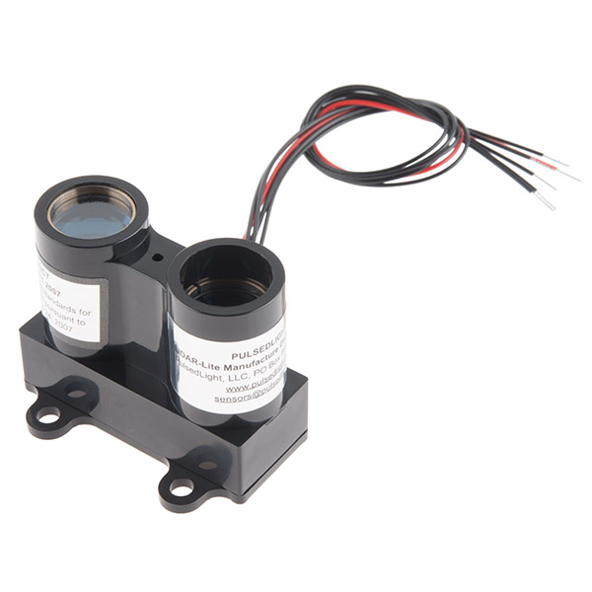
LIDAR Lite
Satellite Technology

Slide 9
Benefits
Ability to capture 3D visualization more accurately
Using less data storage
The ability to integrate with existing software and hardware
Oculus Rift
Stellarium

